Slide 1
Model Selection and Evaluation
Dogs, Fried Chicken or Blueberry Muffins?
Group4: Lin Yanjun; Jiang Chenfei;
Tao Wesley; Wan Qianhui; Yao Jingtian

Slide 2
Model Selection and Evaluation
1. Problem description
2. Model selection
3. Model assessment and comparison
4. Model improvement and prospect
5. Reference

Slide 3
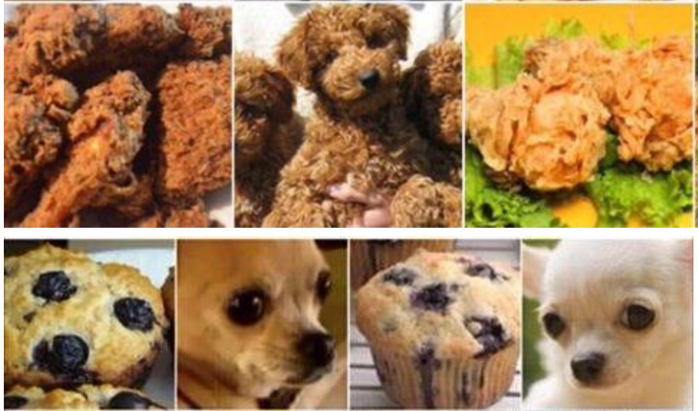
1. Problem description
Dogs, Fried Chicken or Blueberry Muffins?
image classification: the task of extracting information classes from a multiband raster image.
multiclass classification: classifying instances into one of three or more classes.

Slide 4
2. Model selection
2.1 Terminology
Hypothesis/model: a certain function that we believe (or hope) is similar to the true function, the target function that we want to model.
Learning algorithm: a set of instructions that tries to model the target function using our training dataset.
Classifier: a hypothesis or discrete-valued function which is used to assign (categorical) class labels to particular data points.
Hyperparameters: tuning parameters of a machine learning algorithm.
(while model parameters are the parameters that a learning algorithm fits to the training data)

Slide 5
2. Model selection
2.2 feature extraction
ORB(Oriented FAST and Rotated BRIEF): a fusion of FAST keypoint detector and BRIEF descriptor with many modifications to enhance the performance.
SIFT(Scale Invariant Feature Transform): local and based on the appearance of the object at particular interest points, and are invariant to image scale and rotation.
SURF(speeded up robust features): based on the similar principles and steps as SIFT; algorithm contains three main steps: interest point detection, local neighborhood description and matching.

Slide 6
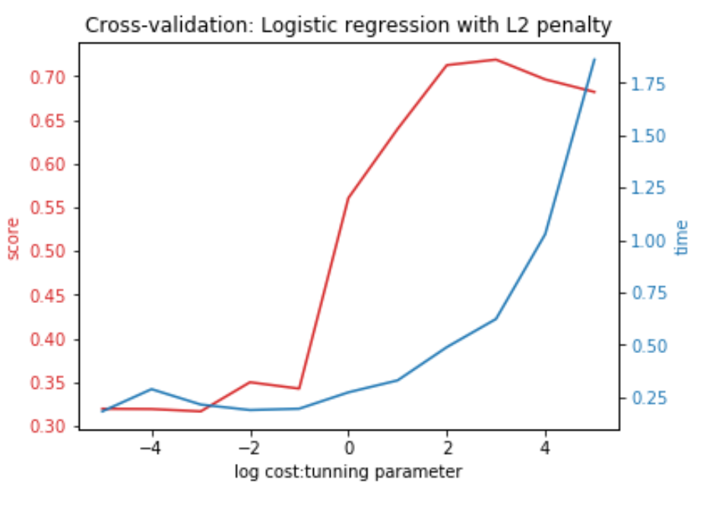
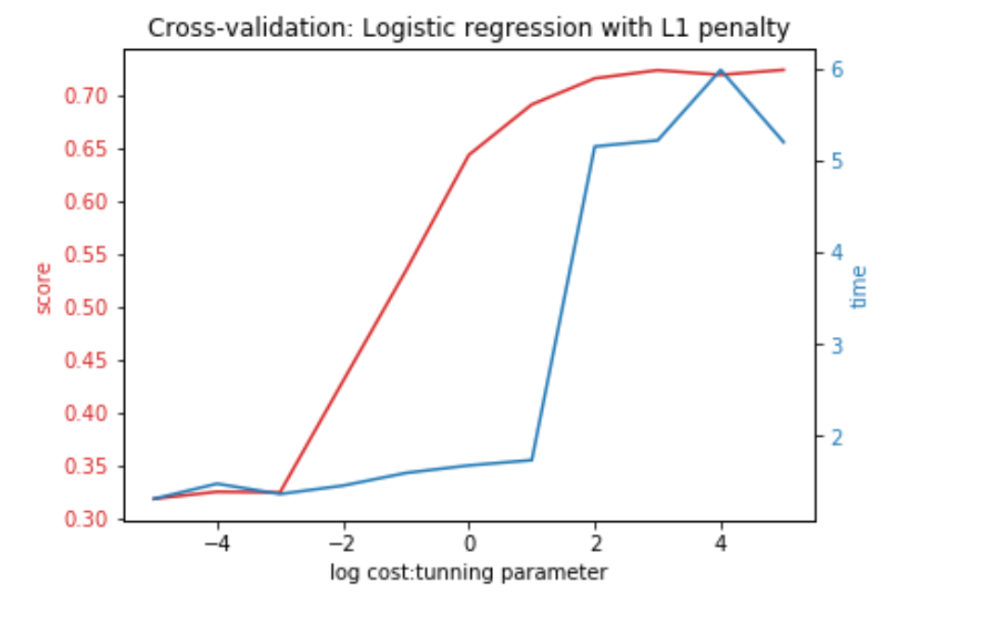
2. Model selection
2.3 basic model comparision
Optimal Logistic Model:
ORG feature
L2 penalty
Linear method
Cost = 1000
Performance: 5-fold-CV score: 0.8147 ; running time per round: 1.5828s.
feature | model
 | Logistic | QDA | LDA | AdaBoost | GBM
SIFT | 0.5827 | 0.3327 | 0.491 | 0.6387 | 0.709
RGB | 0.6407 | 0.553 | 0.579 | 0.8323 | 0.883

Slide 7
2. Model selection
2.4 Alternative advanced model
2.4.1 SVM (Linear/RBF kernel)
Description
Supervised learning models which constructs a hyperplane or set of hyperplanes in a high- or infinite-dimensional space.
Advantage
Effective in high-dimensional spaces, even when dim(n) > p
Memory effective: only depend on support vectors
Versatile: different Kernel functions can be specified for different decision functions
Weakness
Risk of overfitting when n>>p
Calculation expensiveness: calculated using 5-fold CV

Slide 8
2. Model selection
2.4 Alternative advanced model
2.4.2 XGBoost (Extreme Gradient Boosting)
Description
An advanced implementation of gradient boosting algorithm by adding new models sequentially until no further improvement is achieved.
Advantage
Regularization: ‘regularized boosting’ technique, helps to reduce overfit.
Parallel Processing: fast computations
High flexibility: allow to define custom optimization objectives and evaluation criteria.
Have in-built routine to handle missing values
Weakness
Risk of overfitting when not having enough data

Slide 9
2. Model selection
2.4 Alternative advanced model
2.4.3 CNN (MobileNet)
Description
“Vision begins with eyes, but truly takes place in the brain.”
Mostly based on an artificial neural network; using a cascade of multiple layers of nonlinear processing units for feature extraction and transformation .
Advantage
High performance with enough data
Time efficient: reduces the need for feature engineering
Universality: can be adapted to new problems relatively easily
Weakness
Extremely computationally expensive to train
Without strong theoretical foundation, hard to comprehend

Slide 10
3. Model assessment and comparison
3.1. Cost evaluation
feature dimensions
RGB: 5*5*5 SIFT: 2000 MobileNet: 256*256*3
model running time ( cross validation/training/prediction time)
XGBoost (9675.41s/1.46s/0.04s)
SVM (Linear 0.41/3.18/0.40s RBF 2.59/2.45/0.33s)
CNN ( resize 118.69/548.78/22.68s)
3.2 Performance evaluation
Accuracy
Baseline | SVM(linear) | SVM(RBF kernal) | XGBoost(RGB feature) | XGBoost(SIFT feature) | MobileNet
0.883 | 0.589 | 0.742 | 0.889 | 0.678 | 0.993

Slide 11

4. Model improvement and prospect
4.1 Model improvement
4.1.1 Advanced feature
SIFT
Invariant to image scale and rotation.
Robust to changes in illumination, noise, and minor changes in viewpoint.
Highly distinctive, relatively easy to extract and allow for
correct object identification with low probability of mismatch.
RGB
Gradient-based features: makes the scheme robust to illumination variations whereas use of orientation information to define features provides robustness against contrast variations.
(more relevant to the classification problem characteristics)

Slide 12
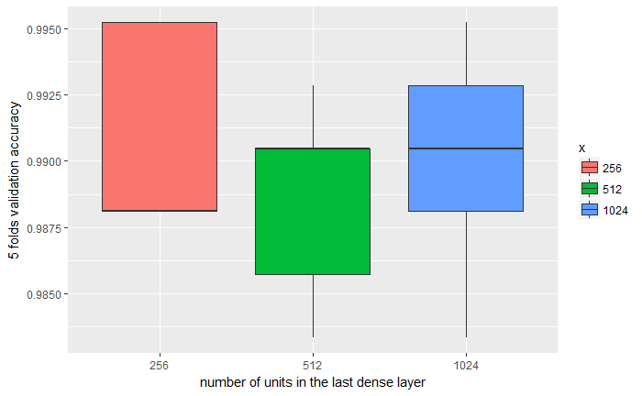
4. Model improvement and prospect
4.1 Model improvement
4.1.2 Parameter tuning
SVM model
Linear: cost: (0.0001,0.001,0.1,1)
RBF: cost: (0.0001,0.001,0.1,1) ; gamma: (0.01,0.1,1,10,100)
XGBoost model
General Parameters
Booster Parameters (eta = 0.15, max_depth = 4)
Learning Task Parameters
CNN(mobile net)
Number of units in the last dense layer: 256

Slide 13
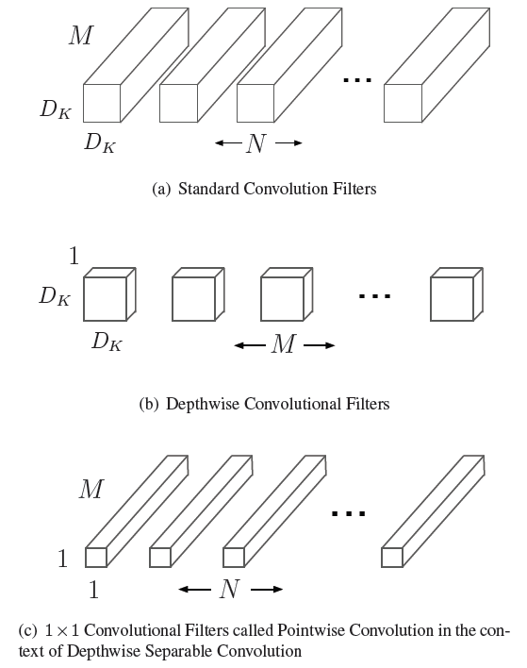
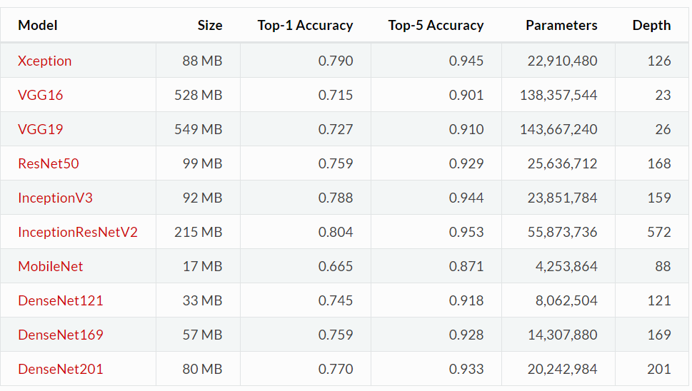
4. Model improvement and prospect5.
4.2 CNN (MobileNet)
CNN model comparison
InceptionV3, Xception vs. MobileNet
Model background
Pretrained by ImageNet, based on a streamlined architecture which uses depth-wise separable convolutions to build light weight deep neural networks.
width multiplier: thinner models;
resolution multiplier: reduced representation
framework: TensorFlow; interface: Keras
data augmentation (flipping, rotation, shifting, zoom-in)
fine tuning ( only train the last layer)

Slide 14
4. Model improvement and prospect
4.2 Prospect
4.2.1 Potential problem
Independence of SIFT feature contradicts the requirement of cross validation.
4.2.2 Further improvement
Standardization
More indicators besides accuracy
(ROC curve, gams & lift charts etc)

Slide 15
5. Reference
[1] Model evaluation, model selection, and algorithm selection in machine learning Sebastian Raschka
[2] Model Evaluation (Classification & Regression) Noureddin Sadawi
[3] Complete Guide to Parameter Tuning in XGBoost (with codes in Python) AARSHAY JAIN
[4] MobileNets: Efficient Convolutional Neural Networks for Mobile Vision Applications
Andrew G. Howard, Menglong Zhu, Bo Chen, Dmitry Kalenichenko, Weijun Wang, Tobias Weyand, Marco Andreetto, Hartwig Adam
[5] Texture Feature Extraction of RGB, HSV, YIQ and Dithered Images using GLCM, Wavelet Decomposition Techniques Manisha Lumb, Poonam Sethi
[6] Xception: Deep Learning with Depthwise Separable Convolutions Franc¸ois Chollet
[7] The Effectiveness of Data Augmentation in Image Classification using Deep Learning Jason Wang, Luis Perez
[8] http://scikit-learn.org/stable/model_selection.html
[9] http://scikit-learn.org/stable/modules/svm.html
[10] https://keras.io/applications/#documentation-for-individual-models
[11] http://blog.csdn.net/u014380165/article/details/75142710

Slide 16
Q&A

Slide 17
Thanks for listening.

